Slide 1
Digital Design & Computer Arch.
Lecture 3a: Mysteries in Comp. Arch.
Prof. Onur Mutlu
ETH Zürich
Spring 2020
27 February 2020

Slide 2
Four Mysteries, Continued
Meltdown & Spectre (2017-2018)
Rowhammer (2012-2014)
Memories Forget: Refresh (2011-2012)
Memory Performance Attacks (2006-2007)

Slide 3
Mystery #3: DRAM Refresh

Slide 4
Recall: DRAM Refresh
DRAM capacitor charge leaks over time
The memory controller needs to refresh each row periodically to restore charge
  Activate each row every N ms
  Typical N = 64 ms
Downsides of refresh
-- Energy consumption: Each refresh consumes energy
  -- Performance degradation: DRAM rank/bank unavailable while refreshed
  -- QoS/predictability impact: (Long) pause times during refresh
  -- Refresh rate limits DRAM capacity scaling

Slide 5
Recall: How Do We Solve the Problem?
Observation: All DRAM rows are refreshed every 64ms.
Critical thinking: Do we need to refresh all rows every 64ms?
What if we knew what happened underneath and exposed that information to upper layers?

Slide 6
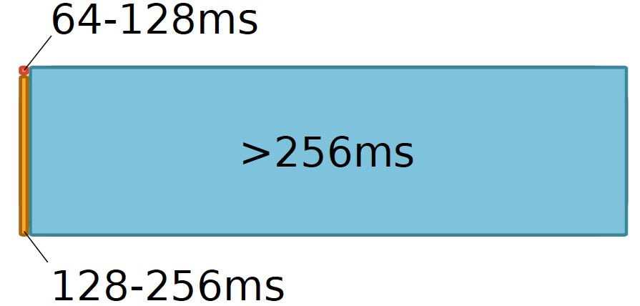

Underneath: Retention Time Profile of DRAM
Liu et al., “RAIDR: Retention-Aware Intelligent DRAM Refresh,” ISCA 2012.

Slide 7
Aside: Why Do We Have Such a Profile?
Answer: Manufacturing is not perfect
Not all DRAM cells are exactly the same
Some are more leaky than others
This is called Manufacturing Process Variation

Slide 8
Opportunity: Taking Advantage of This Profile
Assume we know the retention time of each row exactly
What can we do with this information?
Who do we expose this information to?
How much information do we expose?
  Affects hardware/software overhead, power consumption, verification complexity, cost
How do we determine this profile information?
  Also, who determines it?
Problem
Algorithm
Program/Language
Runtime System
(VM, OS, MM)
ISA (Architecture)
Microarchitecture
Logic
Devices
Electrons

Slide 9
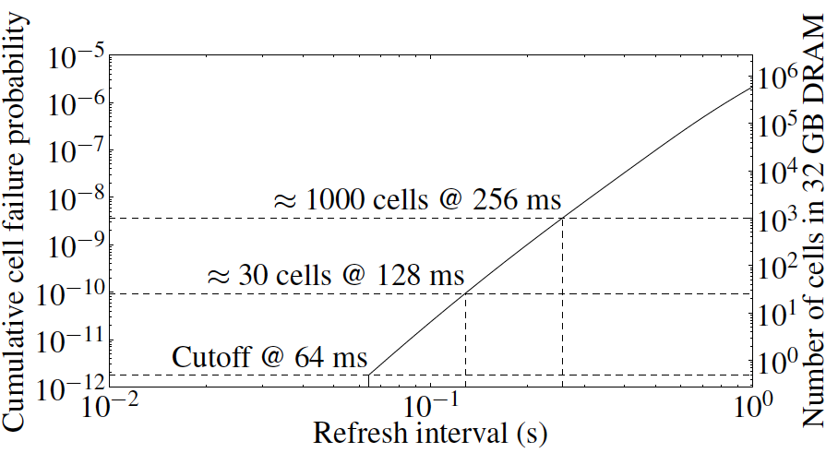
Retention Time of DRAM Rows
Observation: Overwhelming majority of DRAM rows can be refreshed much less often without losing data
Can we exploit this to reduce refresh operations at low cost?
Only ~1000 rows in 32GB DRAM need refresh every 64 ms,
but we refresh all rows every 64ms
Key Idea of RAIDR: Refresh weak rows more frequently,
all other rows less frequently
Liu et al., “RAIDR: Retention-Aware Intelligent DRAM Refresh,” ISCA 2012.

Slide 10
RAIDR: Eliminating Unnecessary DRAM Refreshes
Liu, Jaiyen, Veras, Mutlu,
RAIDR: Retention-Aware Intelligent DRAM Refresh
ISCA 2012.

Slide 11
RAIDR: Mechanism
1. Profiling: Identify the retention time of all DRAM rows
→ can be done at design time or during operation
2. Binning: Store rows into bins by retention time
→ use Bloom Filters for efficient and scalable storage
3. Refreshing: Memory controller refreshes rows in different bins at different rates
→ check the bins to determine refresh rate of a row
1.25KB storage in controller for 32GB DRAM memory
Liu et al., “RAIDR: Retention-Aware Intelligent DRAM Refresh,” ISCA 2012.

Slide 12
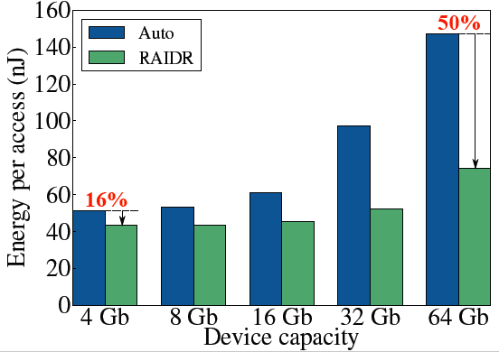
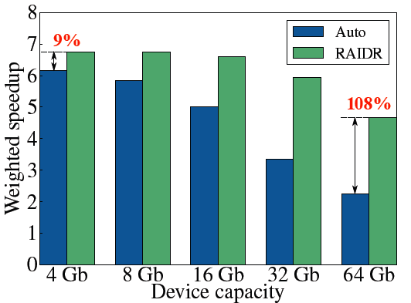
RAIDR: Results and Takeaways
System: 32GB DRAM, 8-core; Various workloads
RAIDR hardware cost: 1.25 kB (2 Bloom filters)
Refresh reduction: 74.6%
Dynamic DRAM energy reduction: 16%
Idle DRAM power reduction: 20%
Performance improvement: 9%
Benefits increase as DRAM scales in density

Slide 13
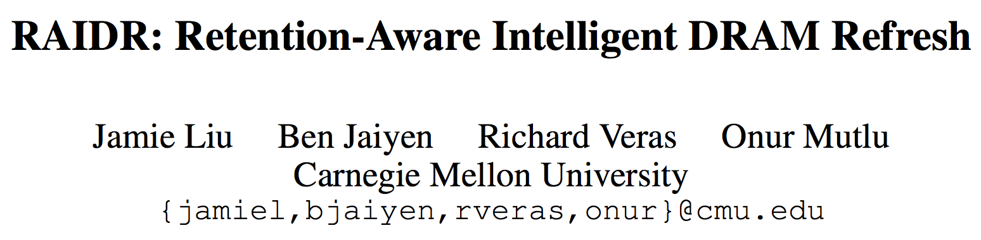
Reading for the Really Interested
Jamie Liu, Ben Jaiyen, Richard Veras, and Onur Mutlu,
"RAIDR: Retention-Aware Intelligent DRAM Refresh"
Proceedings of the 39th International Symposium on Computer Architecture (ISCA), Portland, OR, June 2012. Slides (pdf)

Slide 14
Really Interested? … Further Readings
Onur Mutlu,
"Memory Scaling: A Systems Architecture Perspective"
Technical talk at MemCon 2013 (MEMCON), Santa Clara, CA, August 2013. Slides (pptx) (pdf) Video
Kevin Chang, Donghyuk Lee, Zeshan Chishti, Alaa Alameldeen, Chris Wilkerson, Yoongu Kim, and Onur Mutlu,
"Improving DRAM Performance by Parallelizing Refreshes with Accesses"
Proceedings of the 20th International Symposium on High-Performance Computer Architecture (HPCA), Orlando, FL, February 2014. Slides (pptx) (pdf)

Slide 15
Takeaway
Breaking the abstraction layers (between components and transformation hierarchy levels)
and knowing what is underneath
enables you to understand and solve problems

Slide 16
Mystery #4:
Memory Performance Attacks

Slide 17
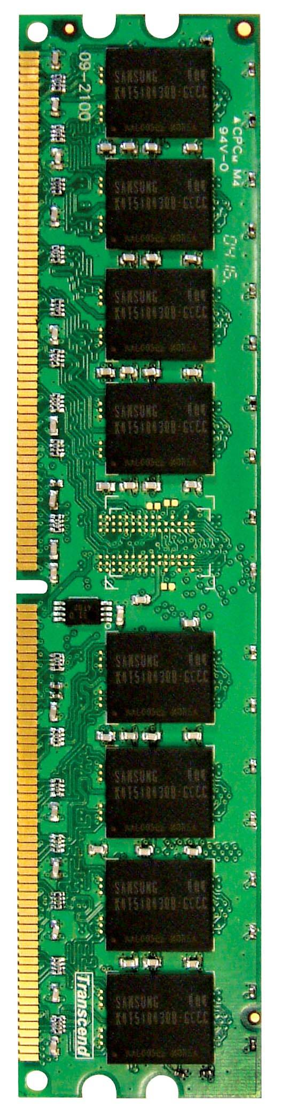
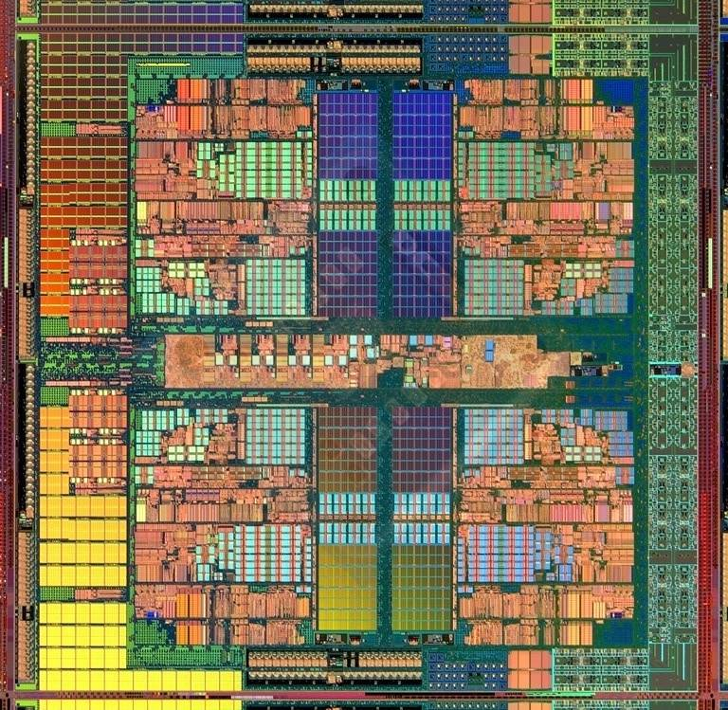
Multi-Core Systems
Multi-Core
Chip
CORE 0
L2 CACHE 1
CORE 1
L2 CACHE 0
SHARED L3 CACHE
DRAM INTERFACE
DRAM MEMORY CONTROLLER
DRAM BANKS
L2 CACHE 2
CORE 3
CORE 2
L2 CACHE 3
*Die photo credit: AMD Barcelona

Slide 18
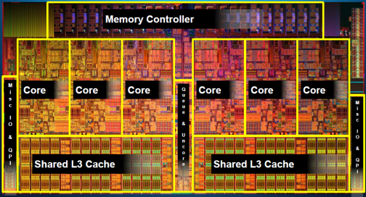
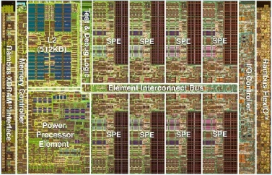
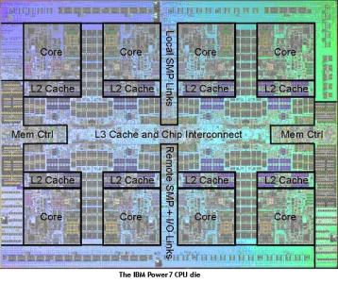
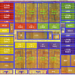
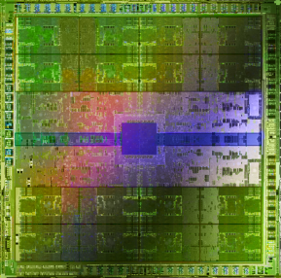
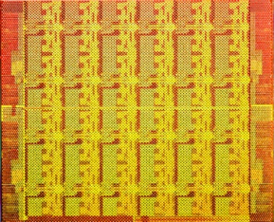
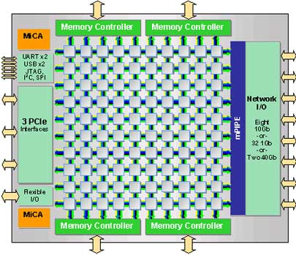
A Trend: Many Cores on Chip
Simpler and lower power than a single large core
Parallel processing on single chip → faster, new applications
Intel Core i7
8 cores
IBM Cell BE
8+1 cores
IBM POWER7
8 cores
AMD Barcelona
4 cores
Nvidia Fermi
448 “cores”
Intel SCC
48 cores, networked
Tilera TILE Gx
100 cores, networked
Sun Niagara II
8 cores

Slide 19
Many Cores on Chip
What we want:
  N times the system performance with N times the cores
What do we get today?

Slide 20
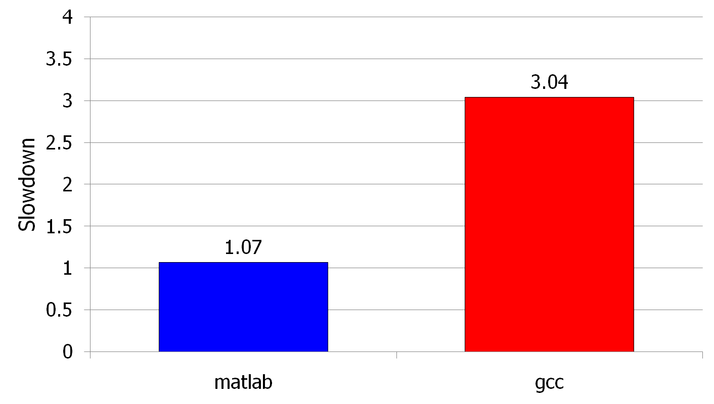
Unexpected Slowdowns in Multi-Core
High priority
Memory Performance Hog
Low priority
(Core 0)
(Core 1)
Moscibroda and Mutlu, “Memory performance attacks: Denial of memory service
in multi-core systems,” USENIX Security 2007.
Notes:
What kind of performance do we expect when we run two applications on a multi-core system? To answer this question, we performed an experiment. We took two applications we cared about, ran them together on different cores in a dual-core system, and measured their slowdown compared to when each is run alone on the same system. This graph shows the slowdown each app experienced. (DATA explanation…)
Why do we get such a large disparity in the slowdowns?
Is it the priorities? No. We went back and gave high priority to gcc and low priority to matlab. The slowdowns did not change at all. Neither the software or the hardware enforced the priorities.
Is it the contention in the disk? We checked for this possibility, but found that these applications did not have any disk accesses in the steady state. They both fit in the physical memory and therefore did not interfere in the disk.
What is it then? Why do we get such large disparity in slowdowns in a dual core system?
I will call such an application a “memory performance hog”
Now, let me tell you why this disparity in slowdowns happens.
Is it that there are other applications or the OS interfering with gcc, stealing its time quantums? No.

Slide 21
Three Questions
Can you figure out why the applications slow down if you do not know the underlying system and how it works?
Can you figure out why there is a disparity in slowdowns if you do not know how the system executes the programs?
Can you fix the problem without knowing what is happening “underneath”?

Slide 22
Three Questions
Why is there any slowdown?
Why is there a disparity in slowdowns?
How can we solve the problem if we do not want that disparity?
  What do we want (the system to provide)?

Slide 23
Why Is This Important?
We want to execute applications in parallel in multi-core systems → consolidate more and more
  Cloud computing
  Mobile phones
We want to mix different types of applications together
  those requiring QoS guarantees (e.g., video, pedestrian detection)
  those that are important but less so
  those that are less important
We want the system to be controllable and high performance

Slide 24
Why the Disparity in Slowdowns?
CORE 1
CORE 2
Multi-Core
Chip
L2
CACHE
L2
CACHE
INTERCONNECT
Shared DRAM
Memory System
DRAM MEMORY CONTROLLER
DRAM
Bank 0
DRAM
Bank 1
DRAM
Bank 2
DRAM
Bank 3

Slide 25
Why the Disparity in Slowdowns?
CORE 1
gcc
Multi-Core
Chip
matlab
CORE 2
L2
CACHE
L2
CACHE
unfairness
INTERCONNECT
Shared DRAM
Memory System
DRAM MEMORY CONTROLLER
DRAM
Bank 0
DRAM
Bank 1
DRAM
Bank 2
DRAM
Bank 3
Notes:
-In a multi-core chip, different cores share some hardware resources. In particular, they share the DRAM memory system. The shared memory system consists of this and that.
When we run matlab on one core, and gcc on another core, both cores generate memory requests to access the DRAM banks. When these requests arrive at the DRAM controller, the controller favors matlab’s requests over gcc’s requests. As a result, matlab can make progress and continues generating memory requests. These requests are again favored by the DRAM controller over gcc’s requests. Therefore, gcc starves waiting for its requests to be serviced in DRAM whereas matlab makes very quick progress as if it were running alone.
Why does this happen? This is because the algorithms employed by the DRAM controller are unfair.
But, why are these algorithms unfair? Why do they unfairly prioritize matlab accesses?
To understand this, we need to understand how a DRAM bank operates.
Almost all systems today contain multi-core chips
Multi-core systems consist of multiple on-chip cores and caches
Cores share the DRAM memory system
DRAM memory system consists of
DRAM banks that store data (multiple banks to allow parallel accesses)
DRAM memory controller that mediates between cores and DRAM memory
It schedules memory operations generated by cores to DRAM
This talk is about exploiting the unfair algorithms in the memory controllers to perform denial of service to running threads
To understand how this happens, we need to know about how each DRAM bank operates

Slide 26
Digging Deeper: DRAM Bank Operation
Access Address:
(Row 0, Column 0)
Columns
This view of a bank is an abstraction.
Internally, a bank consists of many cells (transistors & capacitors) and other structures that enable access
to cells
(Row 0, Column 1)
(Row 0, Column 85)
(Row 1, Column 0)
Row address 0
Row address 1
Row decoder
Rows
Row Buffer
CONFLICT !
HIT
Row 1
HIT
Row 0
Empty
Column address 0
Column mux
Column address 0
Column address 1
Column address 85
Data

Slide 27
DRAM Controllers
A row-conflict memory access takes significantly longer than a row-hit access
Current controllers take advantage of this fact
Commonly used scheduling policy (FR-FCFS) [Rixner 2000]*
  (1) Row-hit first: Service row-hit memory accesses first
  (2) Oldest-first: Then service older accesses first
This scheduling policy aims to maximize DRAM throughput
*Rixner et al., “Memory Access Scheduling,” ISCA 2000.
*Zuravleff and Robinson, “Controller for a synchronous DRAM …,” US Patent 5,630,096, May 1997.

Slide 28
The Problem
Multiple applications share the DRAM controller
DRAM controllers designed to maximize DRAM data throughput
DRAM scheduling policies are unfair to some applications
  Row-hit first: unfairly prioritizes apps with high row buffer locality
    Threads that keep on accessing the same row
  Oldest-first: unfairly prioritizes memory-intensive applications
DRAM controller vulnerable to denial of service attacks
  Can write programs to exploit unfairness

Slide 29
A Memory Performance Hog
// initialize large arrays A, B
for (j=0; j<N; j++) {
index = j*linesize;
A[index] = B[index];
…
}
// initialize large arrays A, B
for (j=0; j<N; j++) {
index = rand();
A[index] = B[index];
…
}
streaming
(in sequence)
random
STREAM
RANDOM
Sequential memory access
Very high row buffer locality (96% hit rate)
Memory intensive
Random memory access
Very low row buffer locality (3% hit rate)
Similarly memory intensive
Moscibroda and Mutlu, “Memory Performance Attacks,” USENIX Security 2007.
Notes:
Streaming through memory by performing operations on two 1D arrays.
Sequential memory access
Each access is a cache miss (elements of array larger than a cache line size) → hence, very memory intensive
Link to the real code…

Slide 30
What Does the Memory Hog Do?
Row decoder
T0: Row 0
T0: Row 0
T0: Row 0
T0: Row 0
T0: Row 0
T0: Row 0
T0: Row 0
T1: Row 5
T1: Row 111
T0: Row 0
T1: Row 16
T0: Row 0
Memory Request Buffer
Row 0
Row Buffer
Row 0
Column mux
Row size: 8KB, request size: 64B
128 (8KB/64B) requests of STREAM serviced before a single request of RANDOM
T0: STREAM
T1: RANDOM
Data
Moscibroda and Mutlu, “Memory Performance Attacks,” USENIX Security 2007.
Notes:
Pictorially demonstrate how stream denies memory service to rdarray
Stream continuously accesses columns in row 0 in a streaming manner (streams through a row after opening it)
In other words almost all its requests are row-hits
RDarray’s requests are row-conflicts (no locality)
The DRAM controller reorders streams requests to the open row over other requests (even older ones) to maximize DRAM throughput
Hence, rdarray’s requests do not get serviced as long as stream is issuing requests at a fast-enough rate
In this example, the red thread’s request to another row will not get serviced until stream stops issuing a request to row 0
With those parameters, 128 requests of stream would be serviced before 1 from rdarray
As row-buffer size increases, which is the industry trend, this problem will become more severe
This is not the worst case, but it is easy to construct and understand
Stream falls off the row buffer at some point
I leave it to the listeners to construct a case worse than this (it is possible)

Slide 31
Now That We Know What Happens Underneath
How would you solve the problem?
What is the right place to solve the problem?
  Programmer?
  System software?
  Compiler?
  Hardware (Memory controller)?
  Hardware (DRAM)?
  Circuits?
Two other goals of this course:
  Enable you to think critically
  Enable you to think broadly
Problem
Algorithm
Program/Language
Runtime System
(VM, OS, MM)
ISA (Architecture)
Microarchitecture
Logic
Devices
Electrons

Slide 32
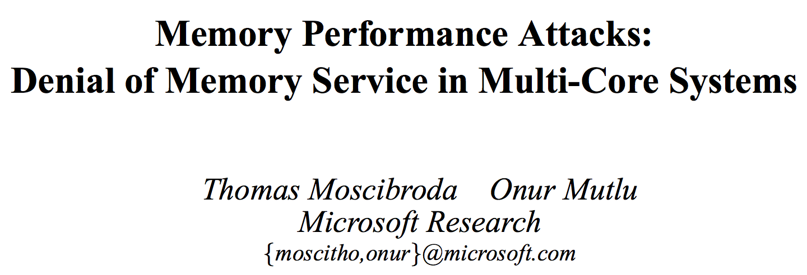
For the Really Interested…
Thomas Moscibroda and Onur Mutlu,
"Memory Performance Attacks: Denial of Memory Service in Multi-Core Systems"
Proceedings of the 16th USENIX Security Symposium (USENIX SECURITY), pages 257-274, Boston, MA, August 2007. Slides (ppt)

Slide 33
Really Interested? … Further Readings
Onur Mutlu and Thomas Moscibroda,
"Stall-Time Fair Memory Access Scheduling for Chip Multiprocessors"
Proceedings of the 40th International Symposium on Microarchitecture (MICRO), pages 146-158, Chicago, IL, December 2007. Slides (ppt)
Onur Mutlu and Thomas Moscibroda,
"Parallelism-Aware Batch Scheduling: Enhancing both Performance and Fairness of Shared DRAM Systems”
  Proceedings of the 35th International Symposium on Computer Architecture (ISCA) [Slides (ppt)]
Sai Prashanth Muralidhara, Lavanya Subramanian, Onur Mutlu, Mahmut Kandemir, and Thomas Moscibroda,
"Reducing Memory Interference in Multicore Systems via Application-Aware Memory Channel Partitioning"
Proceedings of the 44th International Symposium on Microarchitecture (MICRO), Porto Alegre, Brazil, December 2011. Slides (pptx)

Slide 34
Takeaway I
Breaking the abstraction layers (between components and transformation hierarchy levels)
and knowing what is underneath
enables you to understand and solve problems

Slide 35
Takeaway II
Cooperation between
multiple components and layers
can enable
more effective
solutions and systems

Slide 36
Recap: Mysteries No Longer!
Meltdown & Spectre (2017-2018)
Rowhammer (2012-2014)
Memories Forget: Refresh (2011-2012)
Memory Performance Attacks (2006-2007)

Slide 37
Takeaways

Slide 38
Takeaways
It is an exciting time to be understanding and designing computing architectures
Many challenging and exciting problems in platform design
  That no one has tackled (or thought about) before
  That can have huge impact on the world’s future
Driven by huge hunger for data (Big Data), new applications (ML/AI, graph analytics, genomics), ever-greater realism, …
  We can easily collect more data than we can analyze/understand
Driven by significant difficulties in keeping up with that hunger at the technology layer
  Five walls: Energy, reliability, complexity, security, scalability

Slide 39
Computer Architecture as an Enabler of the Future

Slide 40
Assignment: Required Lecture Video
Why study computer architecture?
Why is it important?
Future Computing Architectures
Required Assignment
  Watch Prof. Mutlu’s inaugural lecture at ETH and understand it
  https://www.youtube.com/watch?v=kgiZlSOcGFM
Optional Assignment – for 1% extra credit
  Write a 1-page summary of the lecture and email us
    What are your key takeaways?
    What did you learn?
    What did you like or dislike?
    Submit your summary to Moodle

Slide 41
Digital Design & Computer Arch.
Lecture 3a: Mysteries in Comp. Arch.
Prof. Onur Mutlu
ETH Zürich
Spring 2020
27 February 2020

Slide 42
Backup Slides For Your Benefit. Not Covered in Lecture.

Slide 43
Bloom Filters

Slide 44
Approximate Set Membership
Suppose you want to quickly find out:
  whether an element belongs to a set
And, you can tolerate mistakes of the sort:
  The element is actually not in the set, but you are incorrectly told that it is → false positive
But, you cannot tolerate mistakes of the sort:
  The element is actually in the set, but you are incorrectly told that it is not → false negative
Example task: You want to quickly identify all Mobile Phone Model X owners among all possible people in the world
  Perhaps you want to give them free replacement phones

Slide 45
Example Task
World population
  ~8 billion (and growing)
  1 bit per person to indicate Model X owner or not
  2^33 bits needed to represent the entire set accurately
    8 Gigabits → large storage cost, slow access
Mobile Phone Model X owner population
  Say 1 million (and growing)
Can we represent the Model X owner set approximately, using a much smaller number of bits?
  Record the ID’s of owners in a much smaller Bloom Filter

Slide 46
Example Task II
DRAM row population
  ~8 billion (and growing)
  1 bit per row to indicate Refresh-often or not
  2^33 bits needed to represent the entire set accurately
    8 Gigabits → large storage cost, slow access
Refresh-often population
  Say 1 million
Can we represent Refresh-often set approximately, using a much smaller number of bits?
  Record the ID’s of Refresh-Often rows in a much smaller Bloom Filter

Slide 47
Bloom Filter
[Bloom, CACM 1970]
Probabilistic data structure that compactly represents set membership (presence or absence of element in a set)
Non-approximate set membership: Use 1 bit per element to indicate absence/presence of each element from an element space of N elements
Approximate set membership: use a much smaller number of bits and indicate each element’s presence/absence with a subset of those bits
  Some elements map to the bits other elements also map to
Operations: 1) insert, 2) test, 3) remove all elements
Bloom, “Space/Time Trade-offs in Hash Coding with Allowable Errors”, CACM 1970.

Slide 48
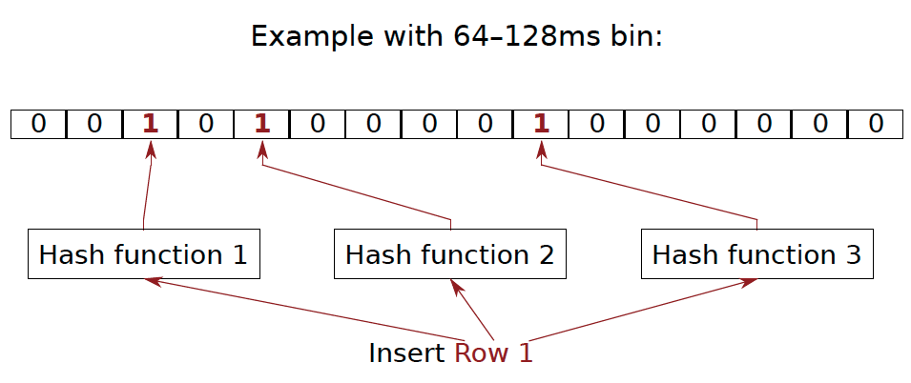
Bloom Filter Operation Example
Bloom, “Space/Time Trade-offs in Hash Coding with Allowable Errors”, CACM 1970.

Slide 49
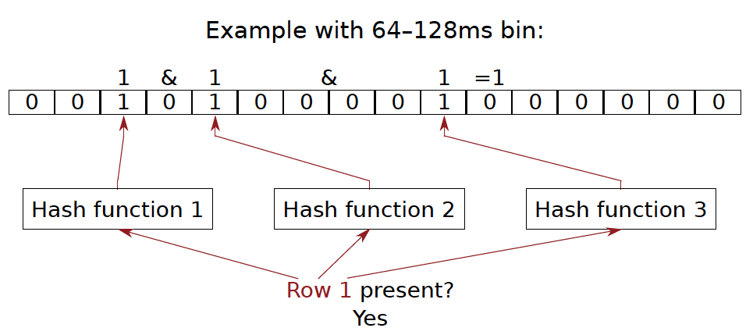
Bloom Filter Operation Example

Slide 50
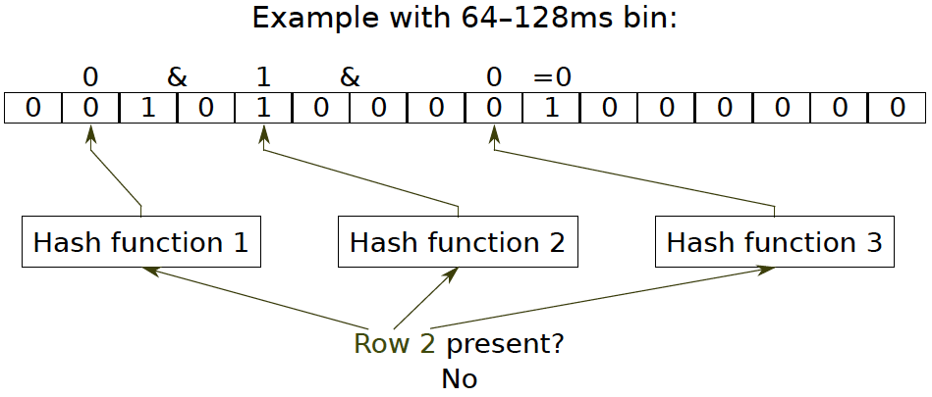
Bloom Filter Operation Example

Slide 51
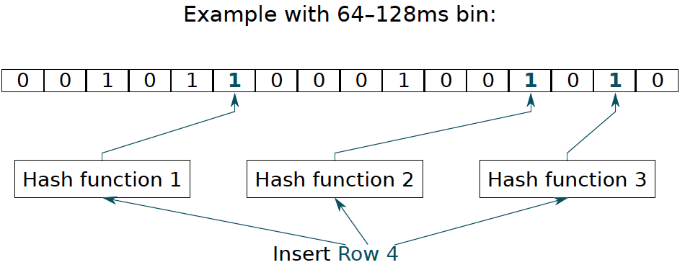
Bloom Filter Operation Example

Slide 52
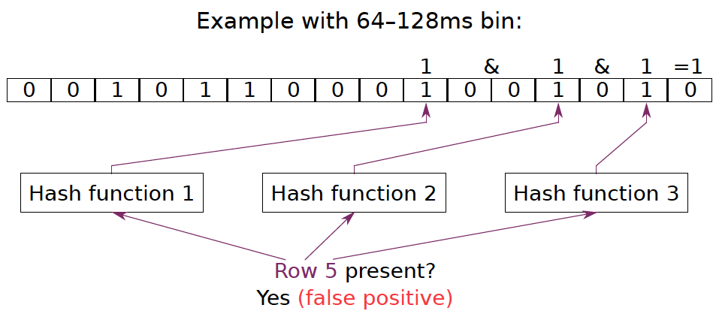
Bloom Filter Operation Example

Slide 53
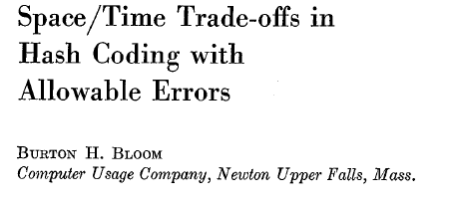
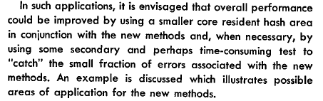
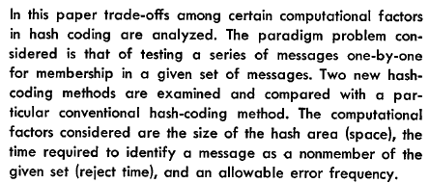
Bloom Filters
Bloom, “Space/Time Trade-offs in Hash Coding with Allowable Errors”, CACM 1970.

Slide 54
Bloom Filters: Pros and Cons
Advantages
  + Enables storage-efficient representation of set membership
  + Insertion and testing for set membership (presence) are fast
  + No false negatives: If Bloom Filter says an element is not present in the set, the element must not have been inserted
  + Enables tradeoffs between time & storage efficiency & false positive rate (via sizing and hashing)
Disadvantages
  -- False positives: An element may be deemed to be present in the set by the Bloom Filter but it may never have been inserted
  Not the right data structure when you cannot tolerate false positives
Bloom, “Space/Time Trade-offs in Hash Coding with Allowable Errors”, CACM 1970.

Slide 55
Benefits of Bloom Filters as Refresh Rate Bins
False positives: a row may be declared present in the Bloom filter even if it was never inserted
  Not a problem: Refresh some rows more frequently than needed
No false negatives: rows are never refreshed less frequently than needed (no correctness problems)
Scalable: a Bloom filter never overflows (unlike a fixed-size table)
Efficient: No need to store info on a per-row basis; simple hardware → 1.25 KB for 2 filters for 32 GB DRAM system

